Slide 1


Computer-Aided Design VHDL Notes
Mahdi Aminian
Some slides courtesy of:
“Hardware Systems Modeling”, A. Vachoux, EPFL
CAD slides from Dr. Saheb Zamani

Slide 2
Generic

Slide 3
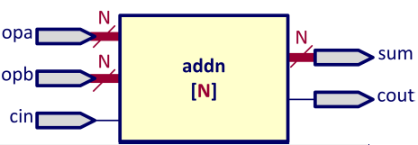
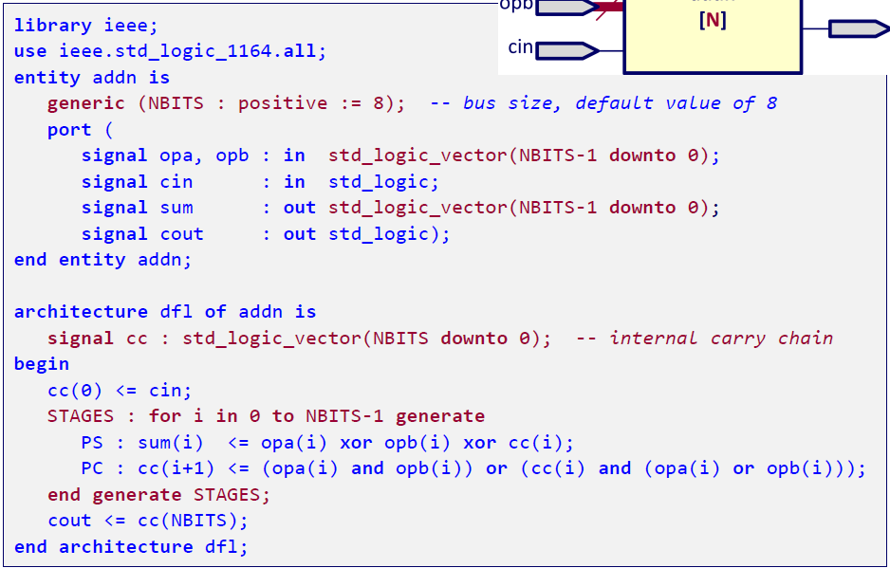
Generic N-bit Adder: Dataflow Architecture

Slide 4
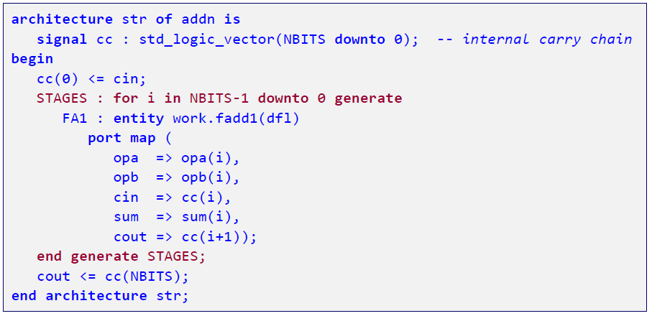
Generic N-Bit Adder: Structural Architecture

Slide 5
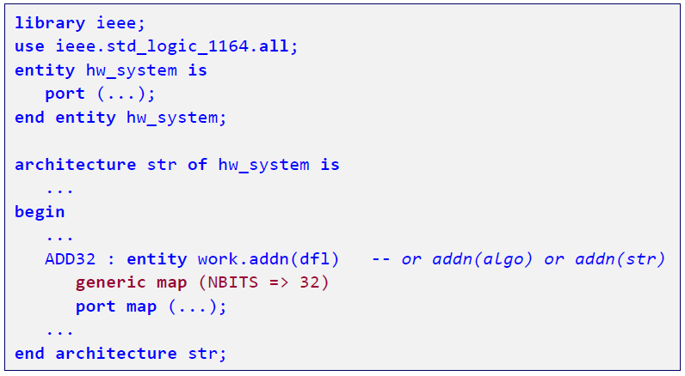
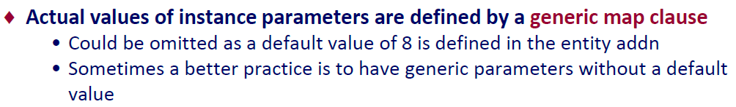
Instantiation of a 32-bit Adder

Slide 6
Synthesis Notes

Slide 7
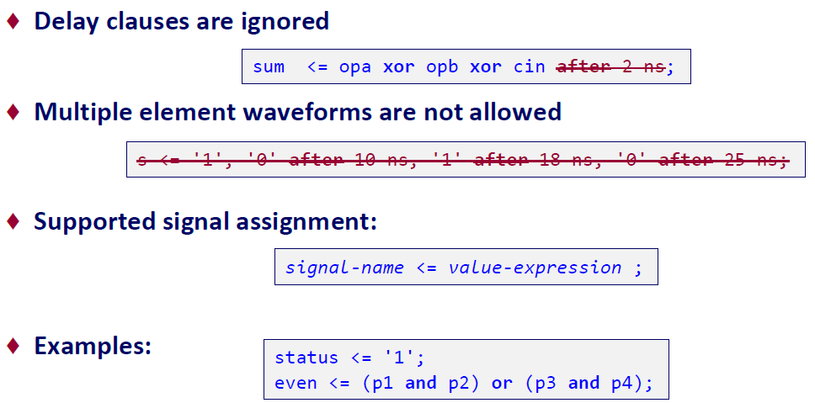
[Synthesis] Simple Concurrent Signal Assignment

Slide 8
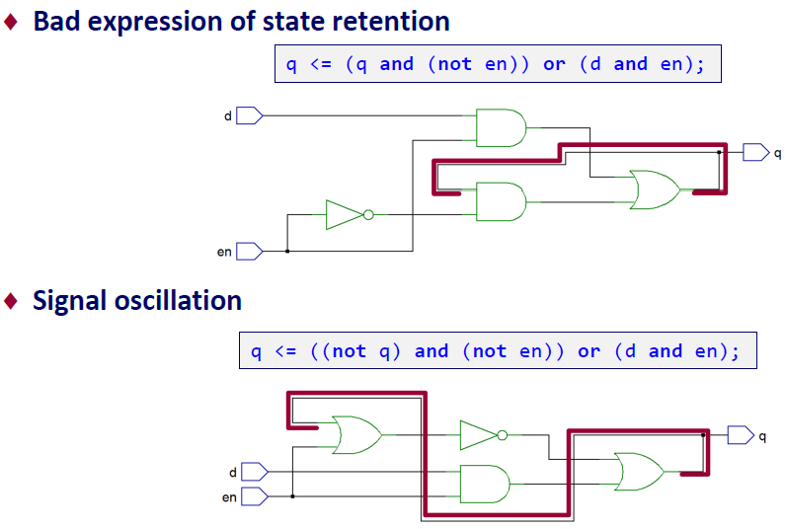
[Synthesis] Avoid Zero-Delay Feedback Loops

Slide 9
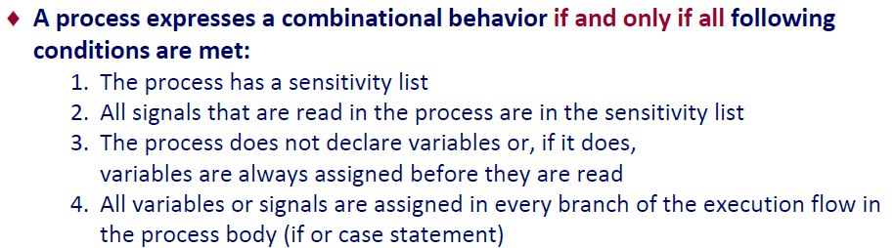
[Synthesis] Combinational Logic from a Process Statement

Slide 10
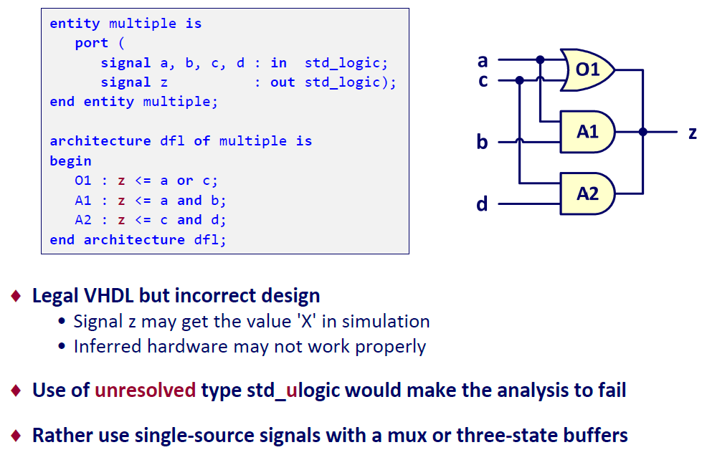
[Synthesis] Avoid Multiple Concurrent Signal Assignments

Slide 11
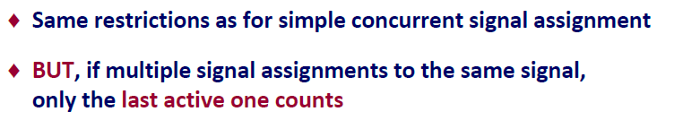
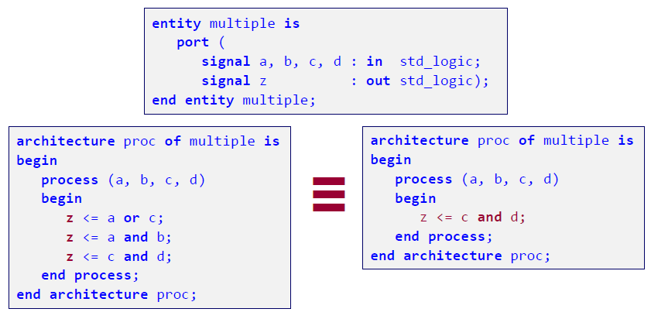
Simple Sequential Signal Assignment

Slide 12

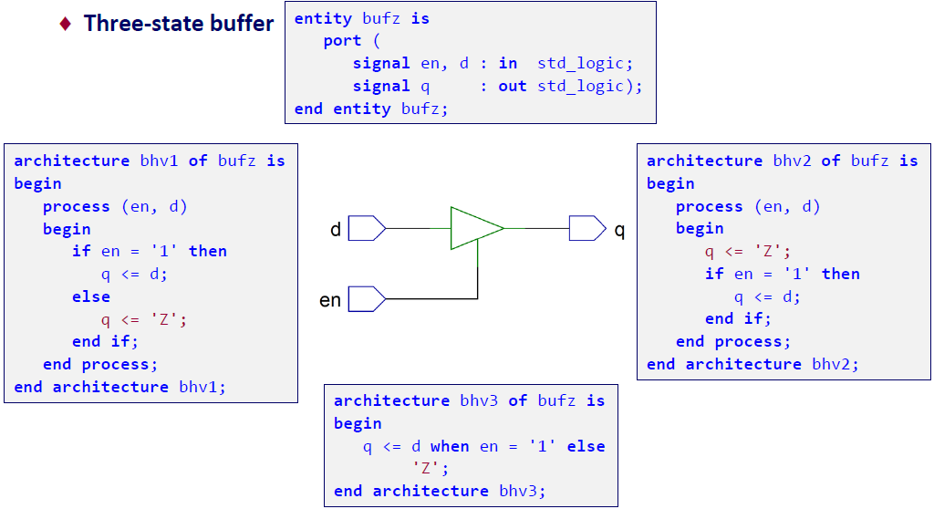
[Synthesis] 'Z' Interpretation

Slide 13
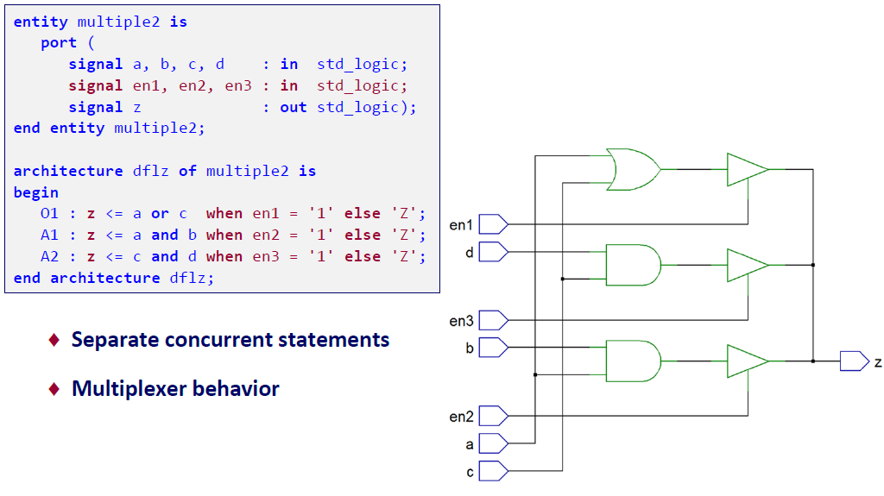
[Synthesis] Multiple Sources and Three-State Buffer

Slide 14
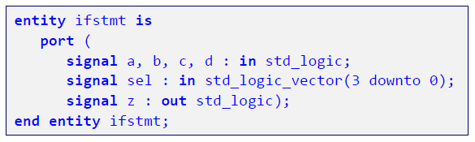
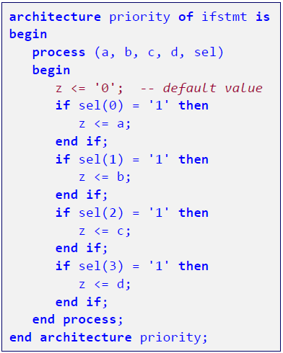

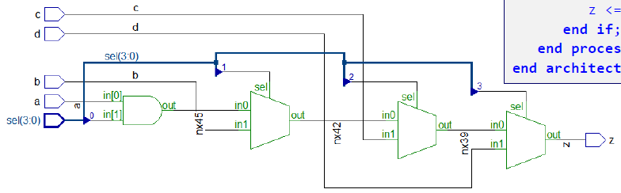
[Synthesis] Sequential If - Priority

Slide 15

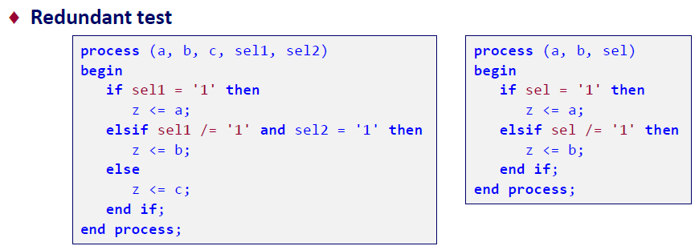
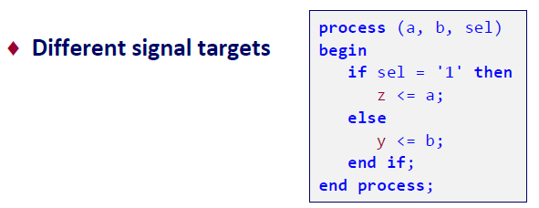
Sequential If Statement Synthesis Pitfalls

Slide 16
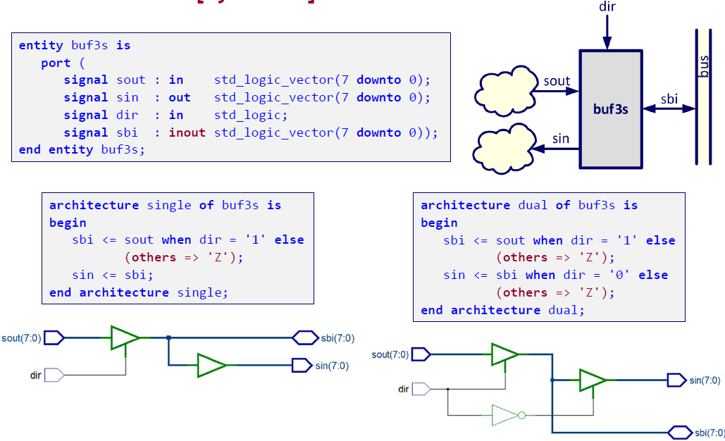
[Synthesis] Bidirectional Bus

Slide 17
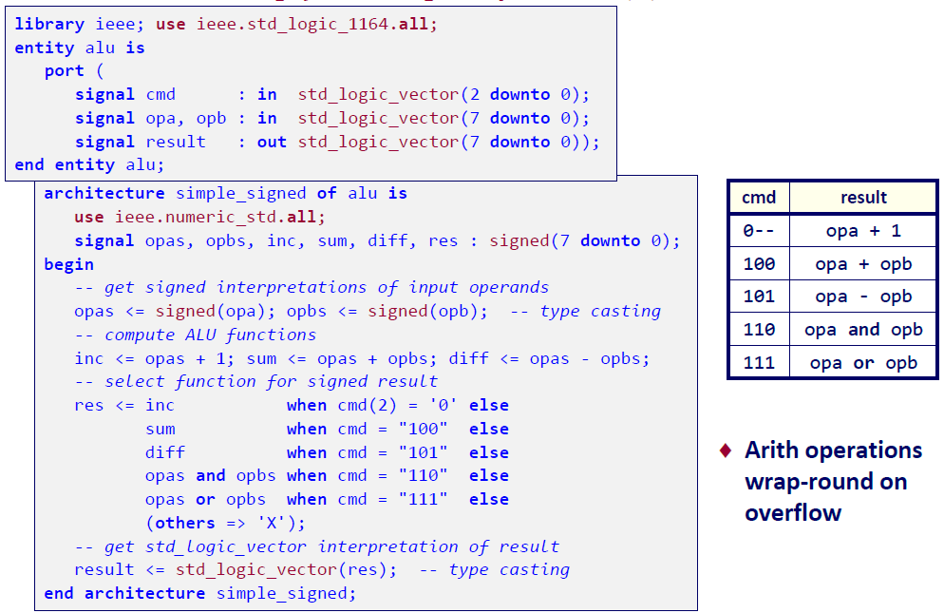
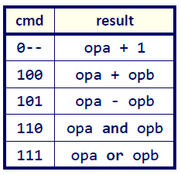
[Synthesis] Simple ALU (1)

Slide 18
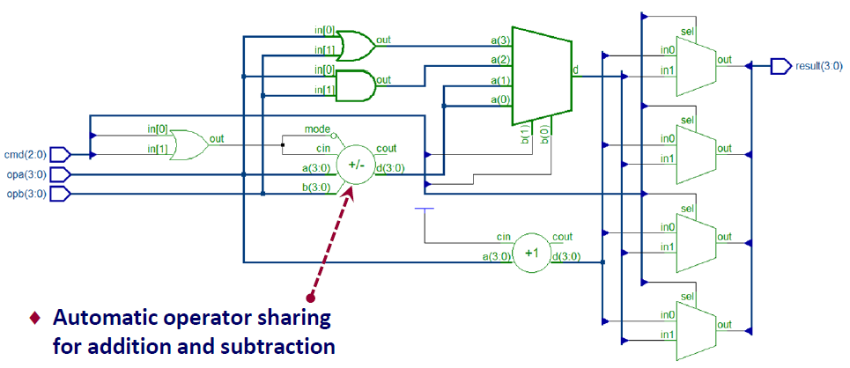
[Synthesis] Simple ALU (2)

Slide 19
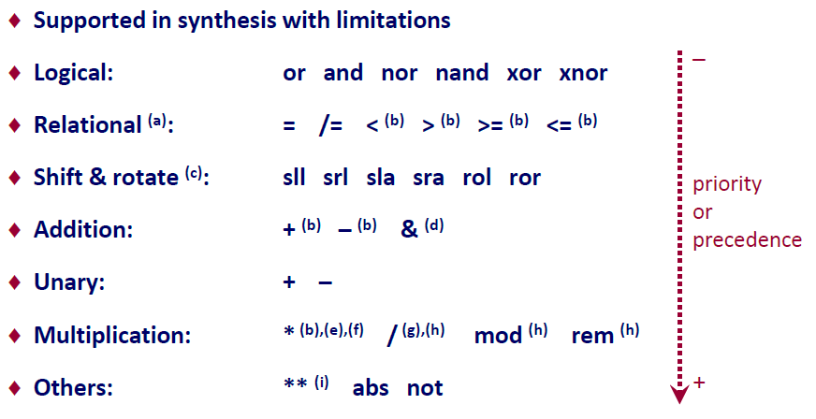
[Synthesis] Hardware Realization of Operators

Slide 20
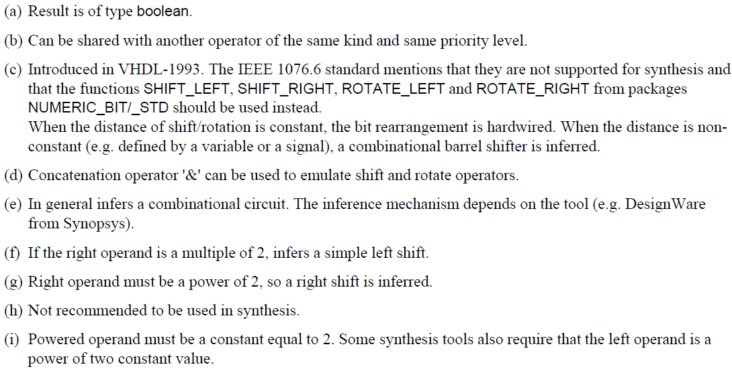
[Synthesis] Hardware Realization of Operators

Slide 21
Simulation Model

Slide 22
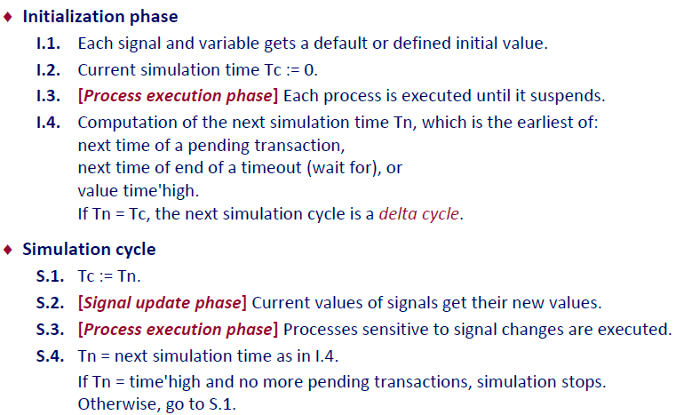
VHDL Simulation Model

Slide 23
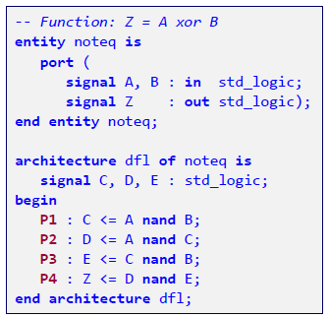
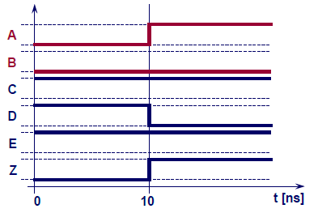
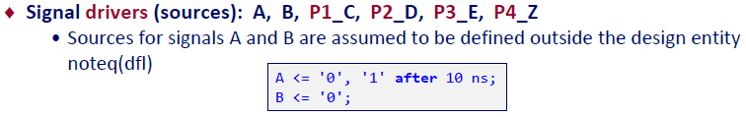
Zero Delay Simulation (Delta Cycle)

Slide 24
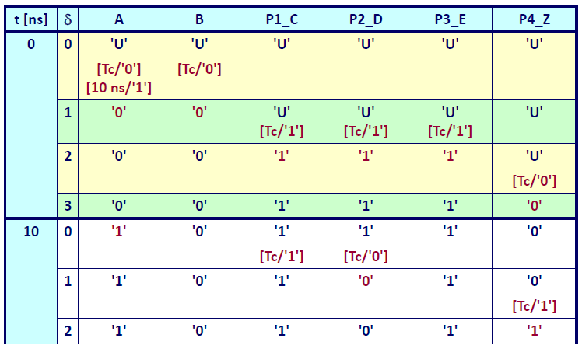
Zero Delay Simulation (Delta Cycle)

